Slide 2
Data Pipeline for Agriculture Data Processing
Leveraging AWS S3 and Snowflake for Efficient Data Management
By: Varun Rathour

Slide 3
Project Objective
Automate the processing of agriculture crop production data.
Use AWS S3 for storage and Snowflake for data processing.
Create a dimensional data model for analysis and reporting.
Enable real-time data ingestion and historical tracking.

Slide 4
Data Source
Kaggle
Uploaded By Mr.Ajaypal Singh(Punjab University)

Slide 5
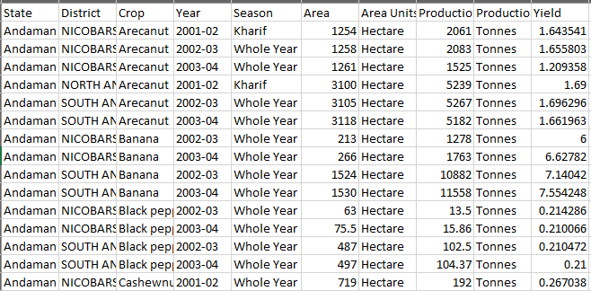
CSV file view overview

Slide 6

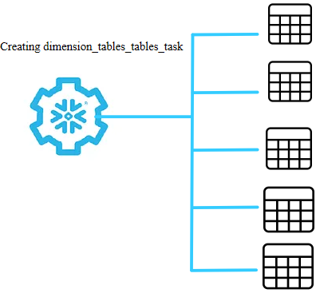



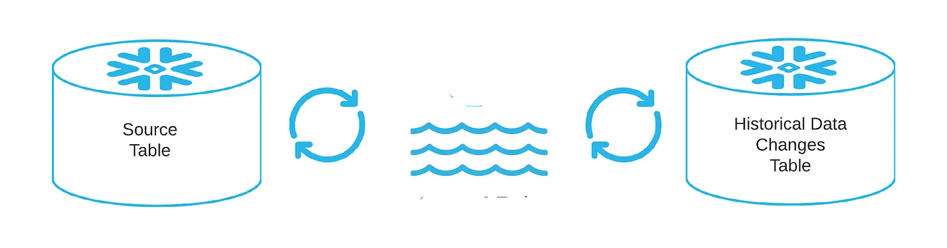

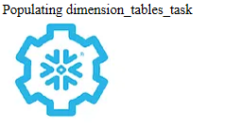



System Architecture
SCHEMA= STAGING
SCHEMA= DIMENSIONS
External Stage
ext_csv_stage
state_dim
 |  |  | Stream
 |  |  | Stream
district_dim
S3 BUCKET
agri_stage_tbl
temp_agri_stage_stream_tbl
crop_dim
s3://agriculturebucket/upload_csv/Agri_dataset.csv
season_dim
year_dim
1) Top 5 Districts Highest Yield Efficiency 2) Seasonal Production in Tonnes 3) State wise Area Utilization Efficiency 4) District wise arecanut_productivity
Creating and populating Fact table_tables_tables_task
Agri_fact

Slide 7
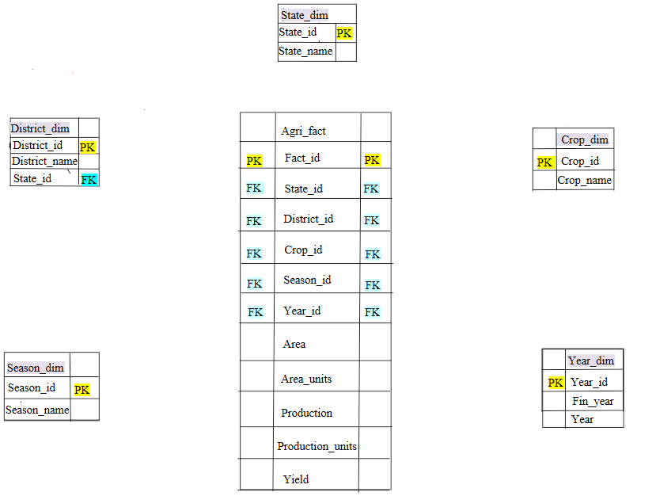
Star Schema Representation

Slide 8
Upload Data to S3
Code working:
Read CSV using pandas. data = pd.read_csv(file_path)
Save updated CSV locally. data.to_csv(file_name, index=False)
Upload file to S3 using Boto3. s3.upload_file(file_name, bucket_name, f'{output_folder}{file_name}')
Key Functions used
boto3.client('s3') for S3 connection.
s3.upload_file for uploading the file.
Output: File uploaded to s3://agriculturebucket/upload_csv/.

Slide 9
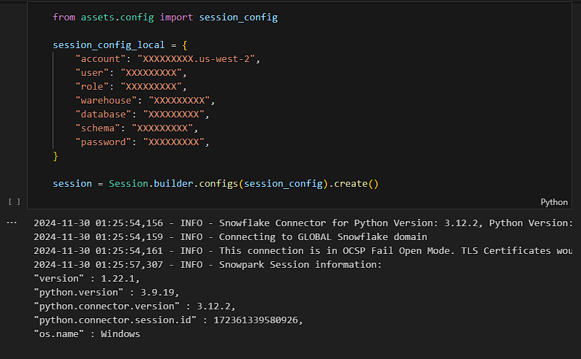
Snowflake Configuration
Code Highlights Created session using Session.builder.configs(session_config).create().

Slide 10
System Architecture
SCHEMA= STAGING
SCHEMA= DIMENSIONS
External Stage
ext_csv_stage
state_dim
 |  |  | Stream
 |  |  | Stream
district_dim
S3 BUCKET
agri_stage_tbl
temp_agri_stage_stream_tbl
crop_dim
s3://agriculturebucket/upload_csv/Agri_dataset.csv
season_dim
1) Top 5 Districts Highest Yield Efficiency 2) Seasonal Production in Tonnes 3) State wise Area Utilization Efficiency 4) District wise arecanut_productivity
year_dim
SCHEMA= FACT
Creating and populating Fact table_tables_tables_task
Agri_fact

Slide 11
Data Staging in Snowflake
Schema Creation: Staging , Dimensions, Fact
File Format: Define CSV-specific attributes.
External Stage: Point to S3 bucket.
Staging Table: Load CSV data for further processing.
Stream and Pipe:
Enable change tracking.
Automate data ingestion. CREATE OR REPLACE PIPE AGRICULTURE.STAGING.agri_pipe
AUTO_INGEST = TRUE
..

Slide 12
Data Transformation
Dimension Tables: Store state, district, crop, season, and year data.
Fact Table: Combine all dimensions with area, production, and yield metrics.
Tasks for Automation:
populate_tables_task: Load dimension tables.
populate_fact_table_task: Populate fact table using joins.
INSERT INTO AGRICULTURE.DIMENSIONS.state_dim (state_name) SELECT DISTINCT State FROM ...

Slide 13


Scheduling and Automation
Automation with Tasks
Task Scheduling:
SCHEDULE = 'USING CRON * * * * * Asia/Kolkata'.
Automates data loading and transformation.
Wait Time:
Ensures tasks run in sequence.
Ensure that all Dimension table gets populated before another task of populating Fact table runs .

Slide 14
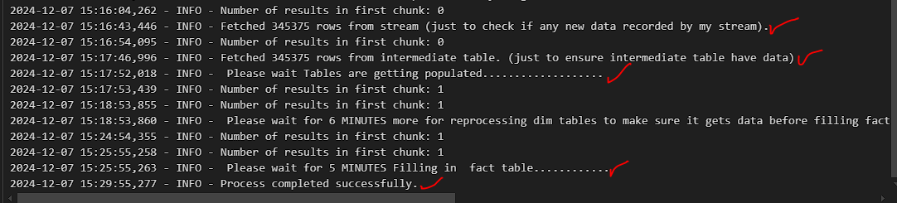
Execution Results
Logs:
Track rows processed and tasks completed.
Final Outputs:
Rows fetched from staging table.
Populated dimension and fact tables.
Sample Log Message: Fetched n rows from staging table.
.
Process completed successfully.

Slide 15
KPI Overview
Source of KPI’s
ICAR Annual Report 2023-2024
KPI’s
Yield Efficiency by District: Crop Improvement (Pages 1-3).
Seasonal Production Trends: Crop Management (Page 66).
Area Utilization Efficiency: Soil and Water Productivity (Page 99).
Arecanut-Specific Productivity Index: Crop Improvement (Pages 1-3).

Slide 16
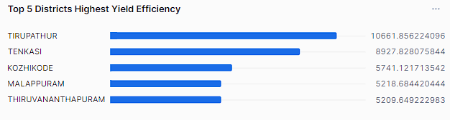
Top 5 districts with the highest yield efficiency
.
SELECT d.district_name,
s.state_name,
(SUM(f.production) / SUM(f.area)) AS yield_efficiency
FROM AGRICULTURE.DIMENSIONS.agri_fact f
JOIN AGRICULTURE.DIMENSIONS.district_dim d
ON f.district_id = d.district_id
JOIN AGRICULTURE.DIMENSIONS.state_dim s
ON d.state_id = s.state_id
GROUP BY d.district_name, s.state_name
ORDER BY yield_efficiency DESC
LIMIT 5;

Slide 17
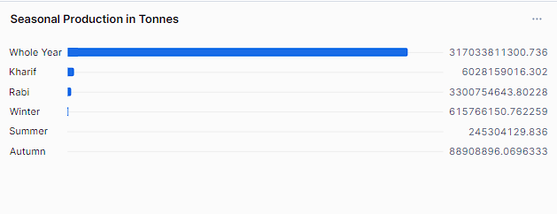
Seasonal Production in Tonnes
SELECT s.season_name, SUM(f.production) AS total_production
FROM AGRICULTURE.FACTS.agri_fact f
JOIN AGRICULTURE.DIMENSIONS.season_dim s ON f.season_id = s.season_id GROUP BY s.season_name ORDER BY total_production DESC;

Slide 18
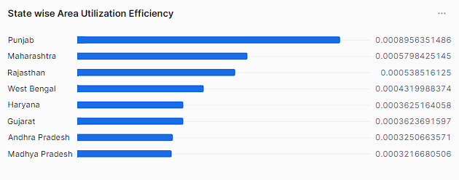
State wise Area Utilization Efficiency
SELECT s.state_name,
d.district_name,
(SUM(f.area) / SUM(total_area.total_area)) * 100 AS area_utilization_efficiency
FROM AGRICULTURE.DIMENSIONS.agri_fact f
JOIN AGRICULTURE.DIMENSIONS.district_dim d
ON f.district_id = d.district_id
JOIN AGRICULTURE.DIMENSIONS.state_dim s
ON d.state_id = s.state_id
JOIN (SELECT SUM(area) AS total_area
FROM AGRICULTURE.DIMENSIONS.agri_fact) total_area
GROUP BY s.state_name, d.district_name
ORDER BY area_utilization_efficiency DESC;

Slide 19
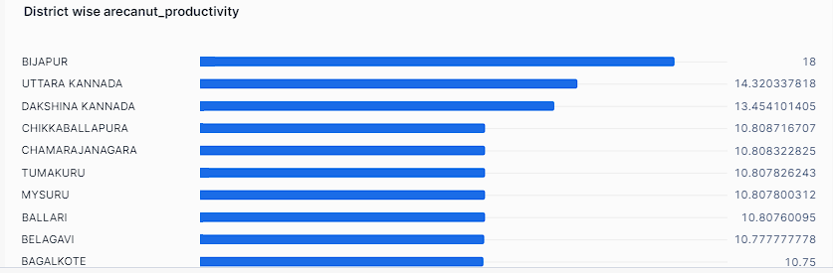
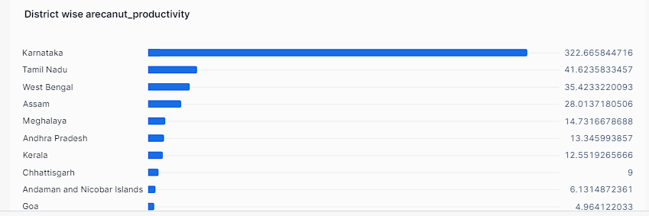
District wise arecanut_productivity
SELECT d.district_name, s.state_name,
(SUM(f.production) / SUM(f.area)) AS arecanut_productivity
FROM AGRICULTURE.DIMENSIONS.agri_fact f
JOIN AGRICULTURE.DIMENSIONS.crop_dim c
ON f.crop_id = c.crop_id
JOIN AGRICULTURE.DIMENSIONS.district_dim d
ON f.district_id = d.district_id
JOIN AGRICULTURE.DIMENSIONS.state_dim s
ON d.state_id = s.state_id
WHERE c.crop_name = 'Arecanut’
GROUP BY d.district_name, s.state_name
ORDER BY arecanut_productivity DESC;

Slide 20
Why This Approach?"
Scalable and cloud-based solution.
Real-time ingestion using Snowflake's stream and pipe.
Historical tracking via staging and stream tables.
Automated dimensional modeling for analytics.

Slide 21
Insights from KPIs
Focus on optimizing low-efficiency districts:
The KPI for "yield efficiency" identified districts with lower agricultural productivity (e.g., low production per unit area).
Recommendation: Concentrate efforts like providing better irrigation, fertilizers, or training to improve farming practices in these districts. Expand crop-specific interventions in high-productivity regions:
The KPI for crop productivity (e.g., Arecanut Productivity) highlights regions where certain crops are performing exceptionally well.
Recommendation: Scale up investments (e.g., funding, subsidies, R&D) in these high-performing areas to further boost output and replicate best practices in similar areas.
Use seasonal insights for resource allocation:
The KPI for total production by season showed which seasons produce more.
Recommendation: Allocate resources (e.g., labor, water, fertilizers) more strategically based on the seasonal peaks to maximize overall productivity.
These insights aim to guide strategic decisions for agricultural improvements.

Slide 22
Concluding Remarks
We did it:🙂👍
Successfully established a pipeline for processing agricultural data.
Generated meaningful insights for decision-making.
Future Scope:
Enhance KPIs with additional dimensions (e.g., climate data).
Automate anomaly detection for production trends.
Integrate predictive modeling for crop yield forecasts.

